Slide 1
Git – Version control tool

Slide 2
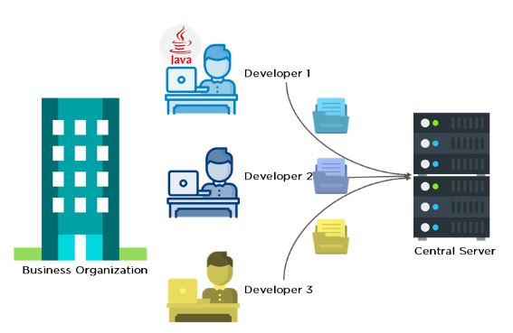
Before diving deep, let’s explain a scenario before Git:
Developers used to submit their codes to the central server without having copies of their own
Any changes made to the source code were unknown to the other developers
There was no communication between any of the developers

Slide 3
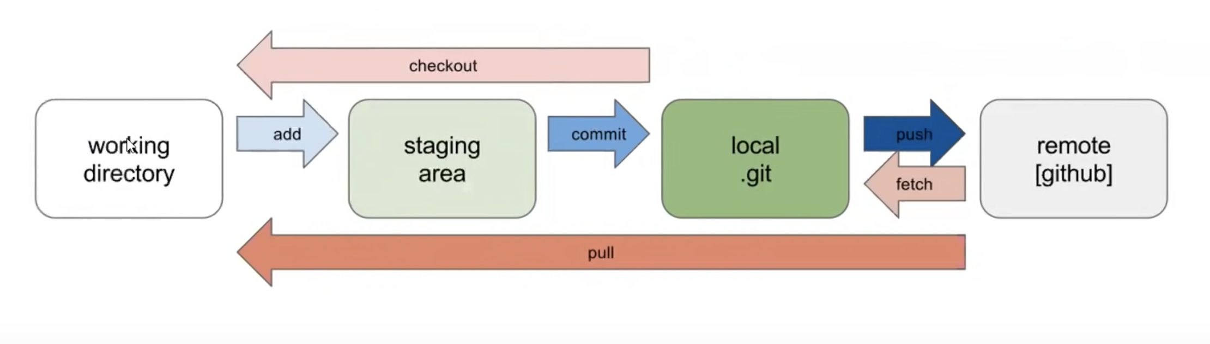
What is Git?
Git is a tool used for,
source code management.
open-source version control system.
Can handle small to very large projects efficiently.
Git is used to tracking changes in the source code.
enabling multiple developers to work together on non-linear development.

Slide 4
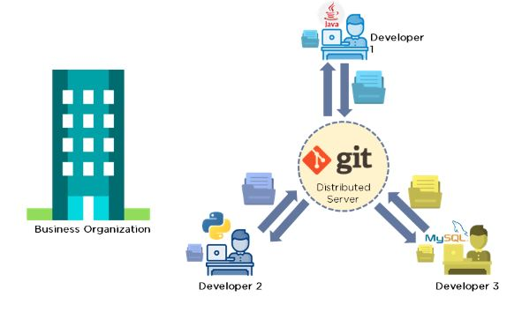
Now let’s look at the scenario after Git:
Every developer has an entire copy of the code on their local systems
Any changes made to the source code can be tracked by others
There is regular communication between the developers

Slide 5
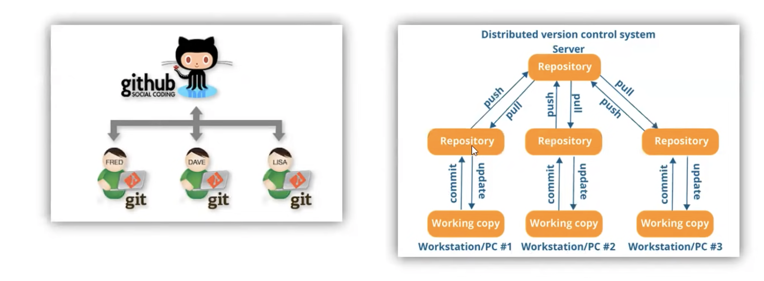
What is GitHub?
GitHub is a hosting service for git repositories. Git is the tool, while GitHub is service to use it.
Conflicts can be resolved using Branching
And merging concepts. We can see in later
Slides about this.

Slide 6
Git Installation on Windows
Step 1:
Download the latest version of Git and choose the 64/32 bit version.
After the file is downloaded, install it in the system.
Once installed, select Launch the Git Bash, then click on finish.
The Git Bash is now launched.
Step 2:
Check the Git version:
Note – You are ready to work with Git repositories.
Command to check git version: git -version

Slide 7
What are git repositories?
While working on Git, we actively use two repositories.
Local repository: The local repository is present on our computer and consists of all the files and folders. This Repository is used to make changes locally, review history, and commit when offline.
Remote repository: The remote repository refers to the server repository that may be present anywhere. This repository is used by all the team members to exchange the changes made.
Both repositories have their own set of commands. There are separate Git Commands that work on different types of repositories.

Slide 8
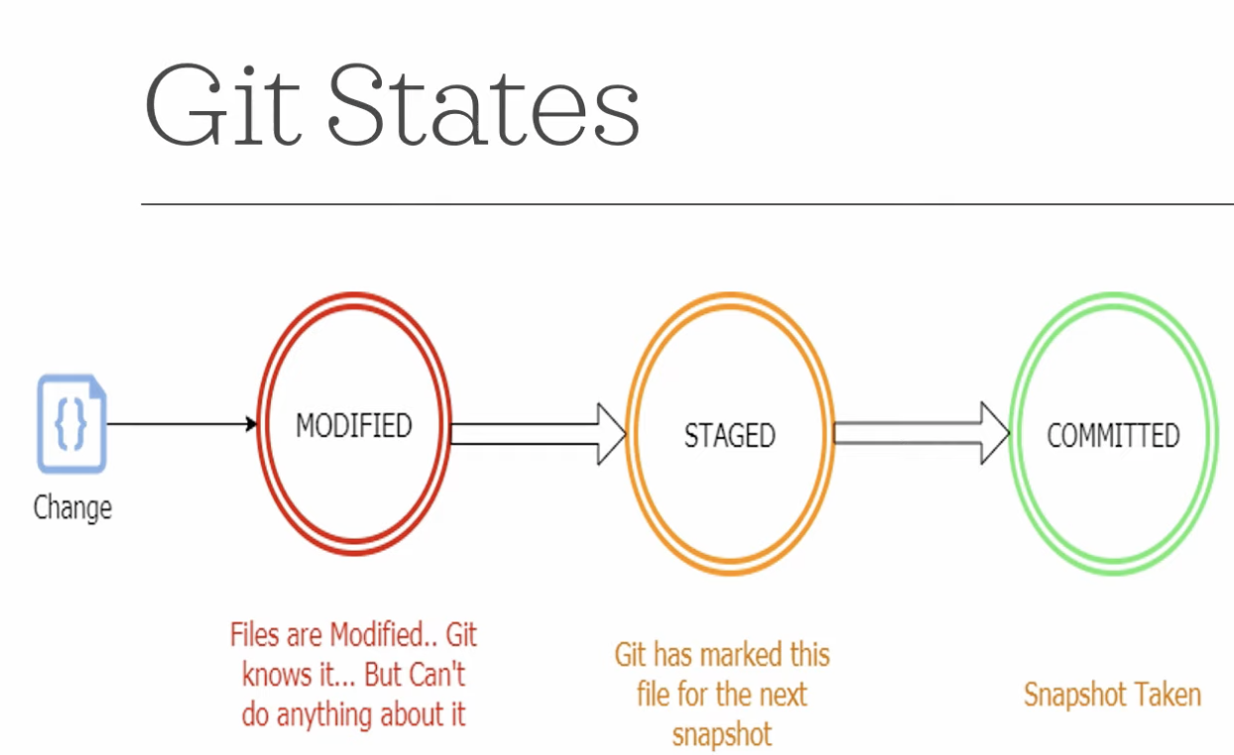

Slide 9
Working with Git – Some ways
Git can be used from command-lie
Git can be integrated to your IDE (Eclipse/IntelliJ IDE)
Using GitHub host to manage all Git functions
In this session, we will see Git usage with both command-line and Eclipse.

Slide 10
Prerequisites to use git/GitHub
Account should be created in GitHub
Git installed on local machine to manage remote/local repositories
Know the repository URL for cloning, pull request and push changes to remote repository

Slide 11
Git & GitHub integrations
Branching
Merging

Slide 12
Git – command line
Make local directory (mkdir test)
Initiate “git init” to initialize the empty repository
Add some files/copy to test directory
Execute “git add ./-A/<filename>
Execute commit to commit the changes to local repo
Push changes to remote repo
Note – before pushing the changes to remote repo, one can create remote repo(GitHub) to map the local repository/files.

Slide 13
Git Commands
Local Repository:
git init – used to initialize blank local repo
git add – make files to staging place
git commit – commit changes to local repo
git status – status of the repo
git config – configure credentials
git branch – create branch
git branch <branch_name>
git branch –a
git branch -d <branch_name>
git checkout – switch branch
git merge – merge different branches into single
Remote Repositories
git remote - use to connect remote repo
git clone – clone the remote repo to local
git pull - pull remote changes to local
git push – push changes to remote repo from local repo
Some Advanced Git Commands
Git stash – store locally as temporary snapshot

Slide 14
What is .git ? And why it is hidden?
When you initialize empty local repo it will create hidden directory called “.git”.
The .git folder will contain details of every single change made to the code base.
All snapshots of the modifications will be recorded in this folder like a database, which makes it possible to undo the changes and rollback to the desired version of the code.
The .git folder is hidden to prevent accidental deletion or modification of the folder.
The version history of the code base will be lost if this folder is deleted
Cannot roll back changes to made to the code in the future.
hooks − This folder contains script files. Git hooks are the scripts that are executed before or after events like commit, push etc.
objects − This folder represents an object database of Git.
config − This is the local configuration file.
refs − This folder stores information about tags and branches.
HEAD − This file stores reference to the current branch. It points to the master branch by default.
index − This is a binary file and stores staging information

Slide 15
Git plugin – Eclipse
Latest Eclipse versions by default comes with Git plugin installed.
Incase Git is not installed, one can install by following the below series of steps:
Eclipse install Git plugin – Step by Step installation instruction:
Go to: http://eclipse.org/egit/download/ to get the plugin repository location.
elect appropriate repository location. In my case its http://download.eclipse.org/egit/updates
In eclipse Go to Help > Install New Software
To add repository location, Click Add. Enter repository name as “EGit Plugin”. Location will be the URL copied from Step 2. Now click Ok to add repository location.
Wait for a while and it will display list of available products to be installed. Expend “Eclipse Git Team Provider” and select “Eclipse Git Team Provider”. Now Click Next
Review product and click Next.
It will ask you to Accept the agreement. Accept the agreement and click Finish.
Within few seconds, depending on your internet speed, all the necessary dependencies and executable will be downloaded and installed.
Accept the prompt to restart the Eclipse.
Your Eclipse Git Plugin installation is complete.
To verify your installation.
Go to Help > Install New Software
Click on Already Installed and verify plugin is installed.

Slide 16
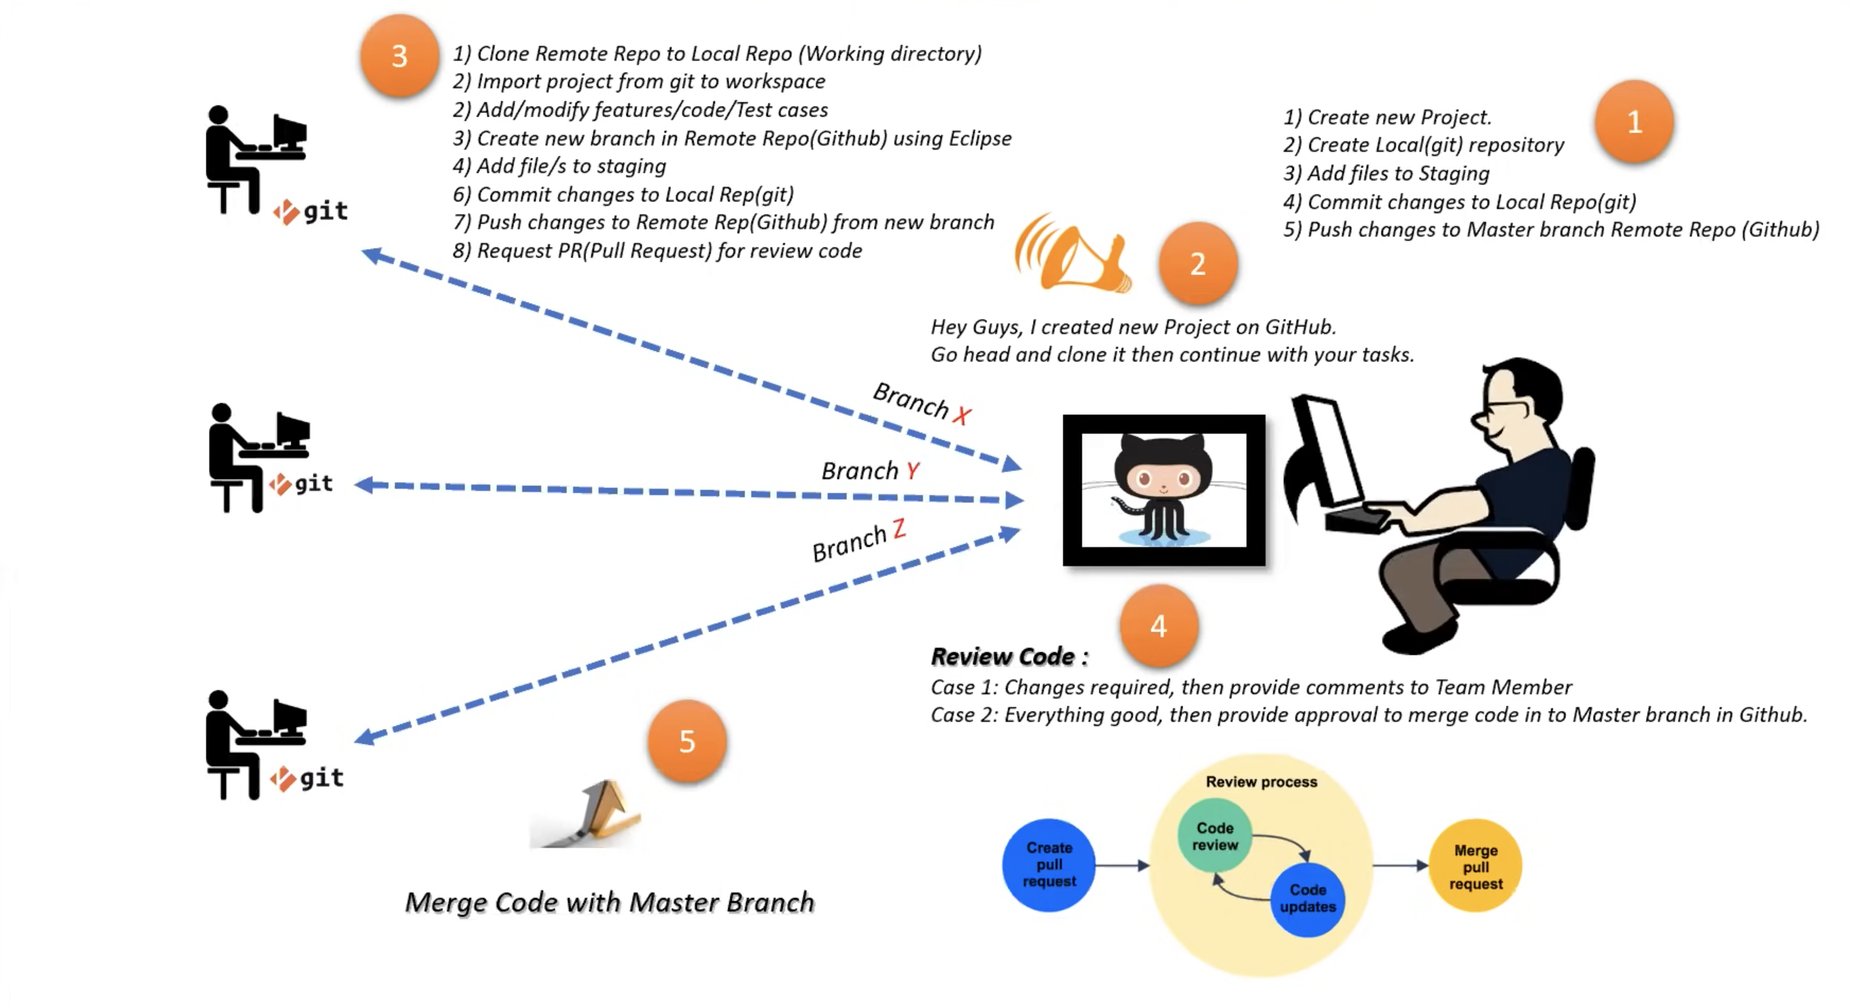
Git end-to-end workflow - Eclipse

Slide 17
Git-Usecases
Usecase 1:
Create java project and commit changes to local repo and finally push to remote repo.
Usecase 2:
Get latest changes from remote repo to local repo – pull request
Usecase 3:
Clone remote repo to local repo
Import project from local repo to eclipse.
Branch creation and
Making pull request to merge branch to master branch.

Slide 18
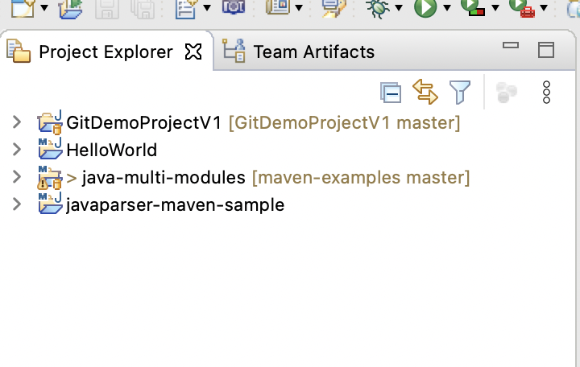
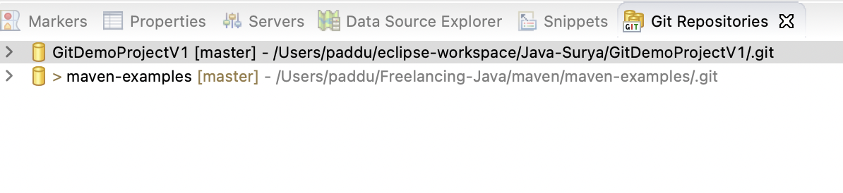
Git end-to-end workflow - Eclipse
Create local eclipse project and push changes to remote repository(GitHub).
Create new java project
Create local repository using eclipse
Add files to local repository
Push new project to remote repository(GitHub)
Eclipse screens:

Slide 19
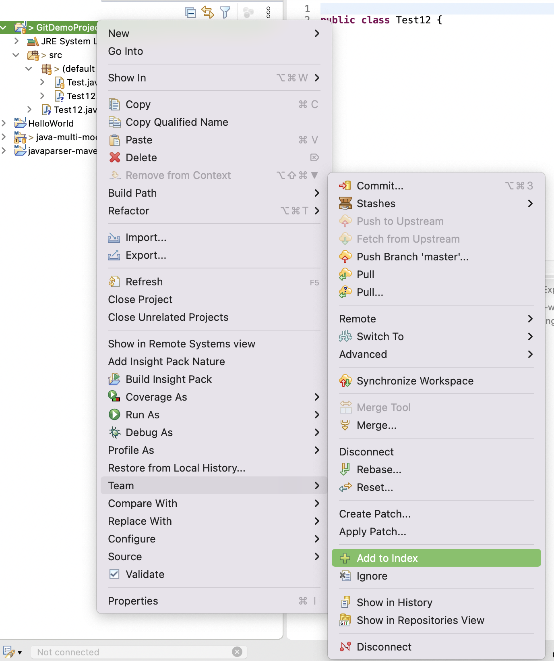
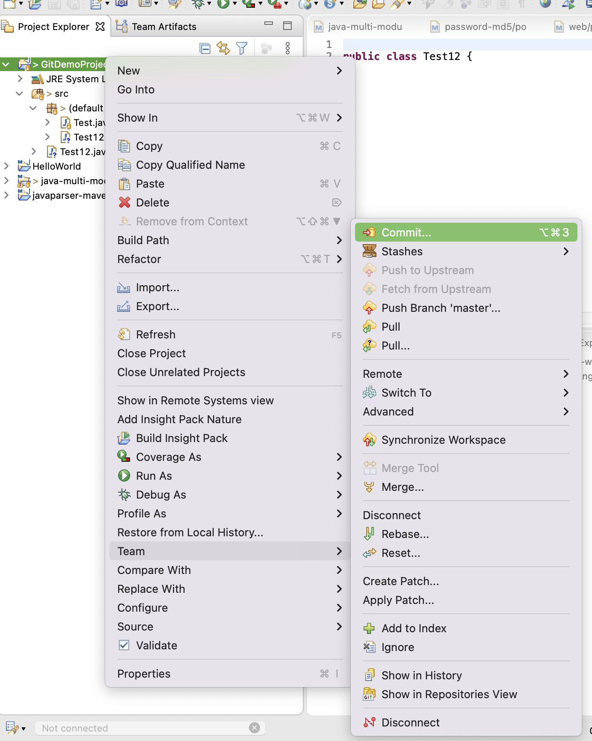
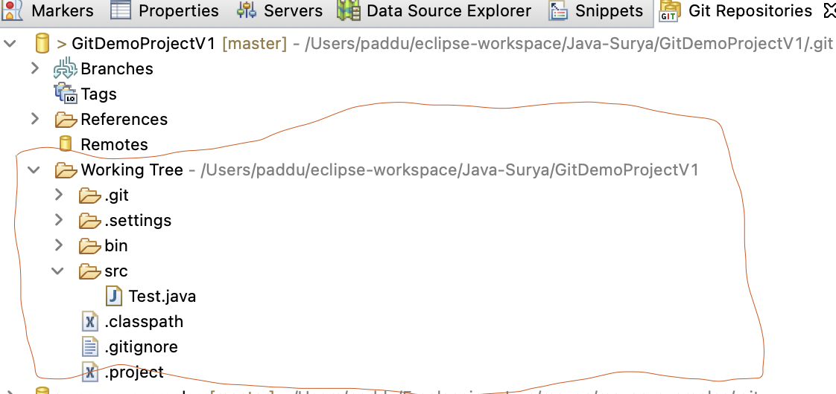
Git end-to-end workflow – Local to remote(push)
Right click project -> share/ goto git repositories section to create local repo
Make some changes to the source files if required
Right click project -> Team ->click “add to index” (it will add all new files to staging area)
Right click project -> Team -> click “commit” provide the commit message and click commit (This will commit your changes to local repo)
git add
git commit

Slide 20
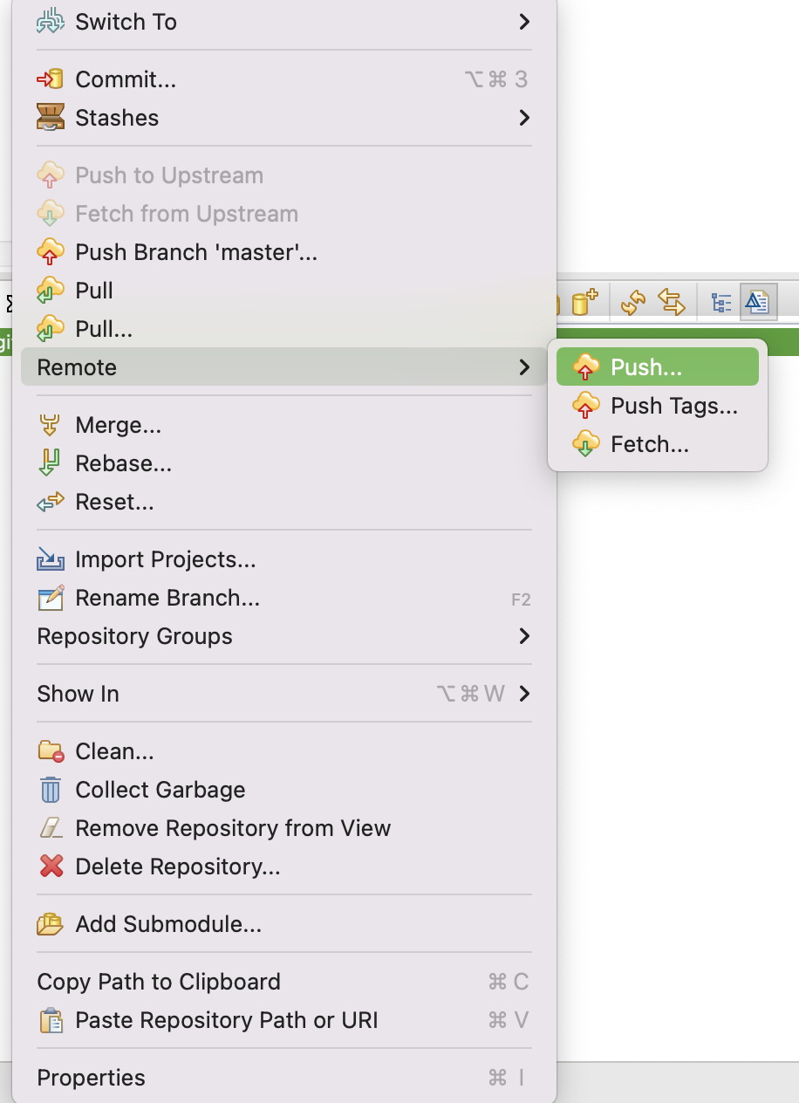
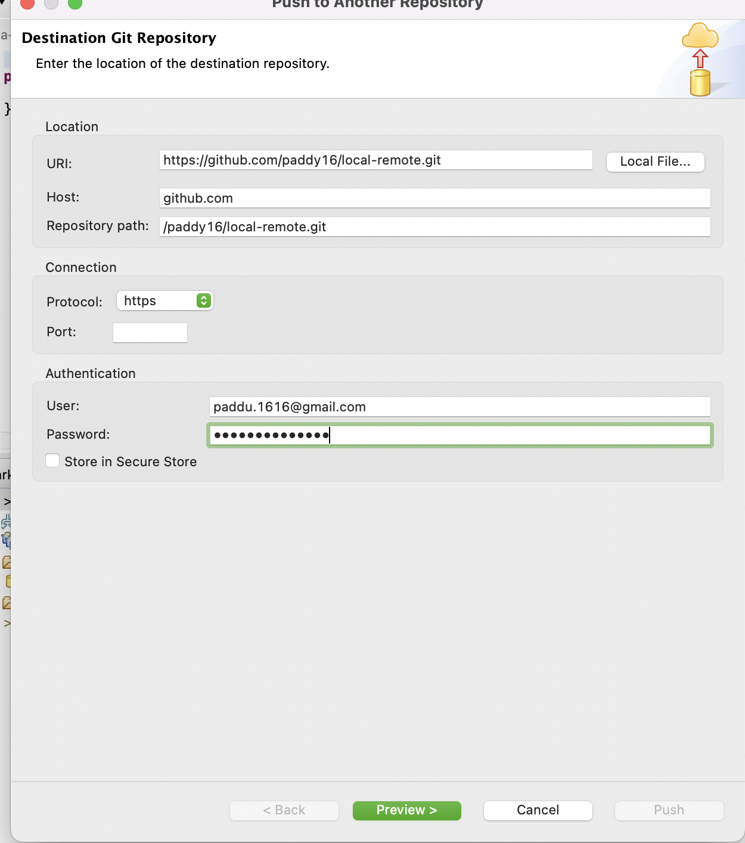
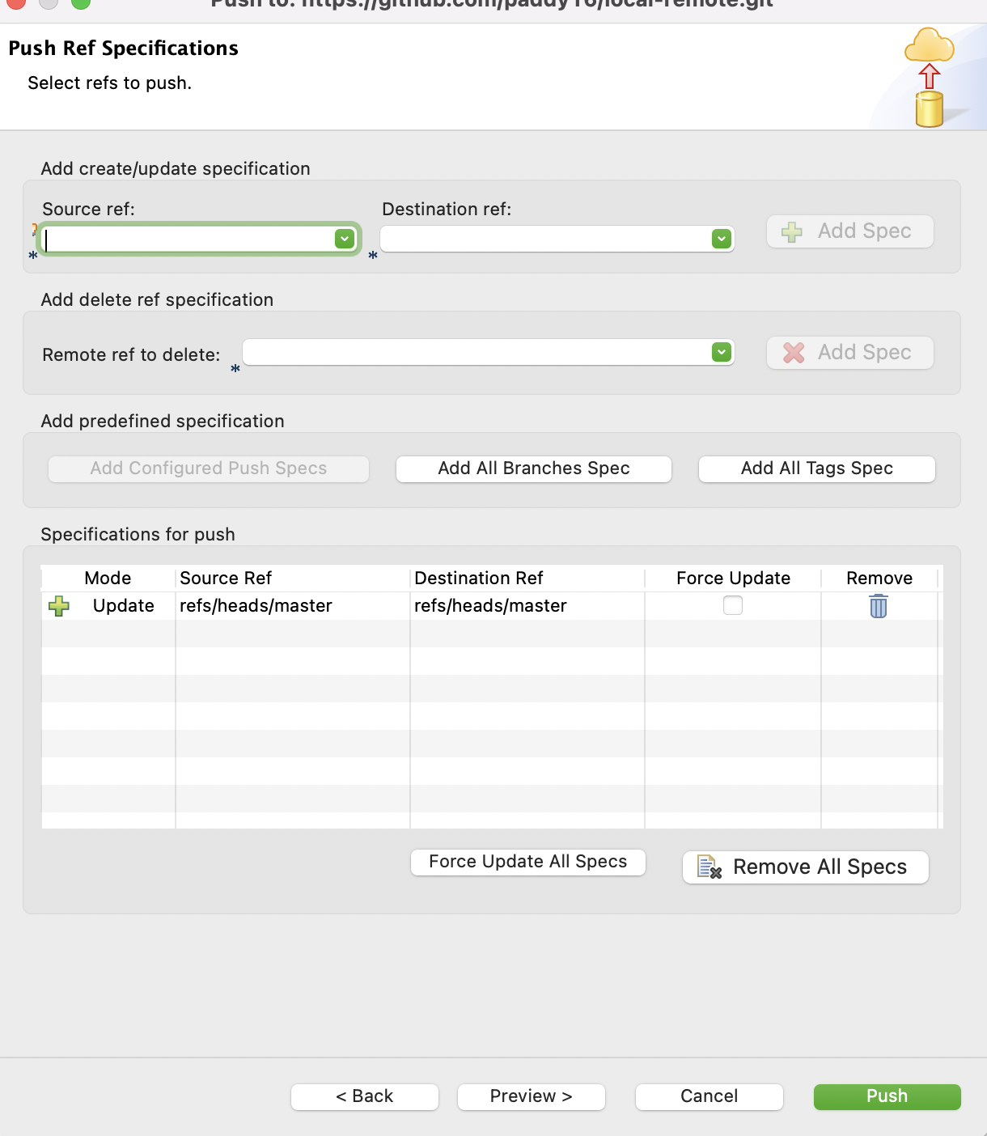
Git end-to-end workflow – push
Hope you already created hit account and know the repo URL and credentials. ( your project lead/manager can create remote repo and share the details)
Remote repo created in GitHub.
Go back to eclipse and right click “local git repo” -> select ”remote” ->. Click push and provide the remote repo URL and username and password and click next and click finish.
Select always “master” as your preferred branch and click “add spec” and click push button.
Now all your local repo files are uploaded into remote repo.
You can login to GitHub and select respective branch and verify all the files are pushed to remote repo.

Slide 21
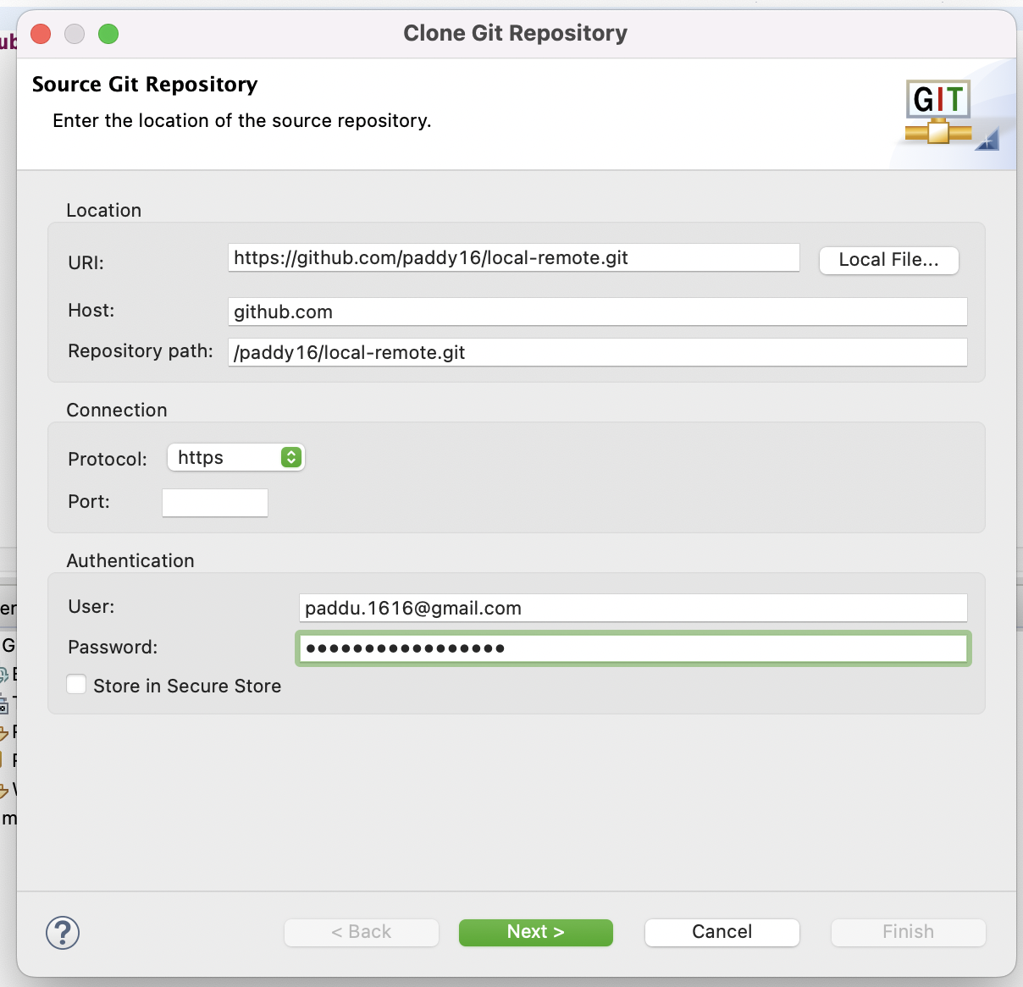
Git end-to-end workflow – pull request
Add collaborators in GitHub against to remote repository and share the repo URL to other team members to clone the repo and work simultaneously.
After that test/other dev to launch that shared URL using his own credentials and accept the invitation.
Clone remote repo to local git
Import project from git repo to workspace
Add/modify feature
Create new branch in remote repo(GitHub) using eclipse
Add file(s) to staging
Commit changes to local git repo
Push changes to remote repo from new branch
Request PR for code review

Slide 22
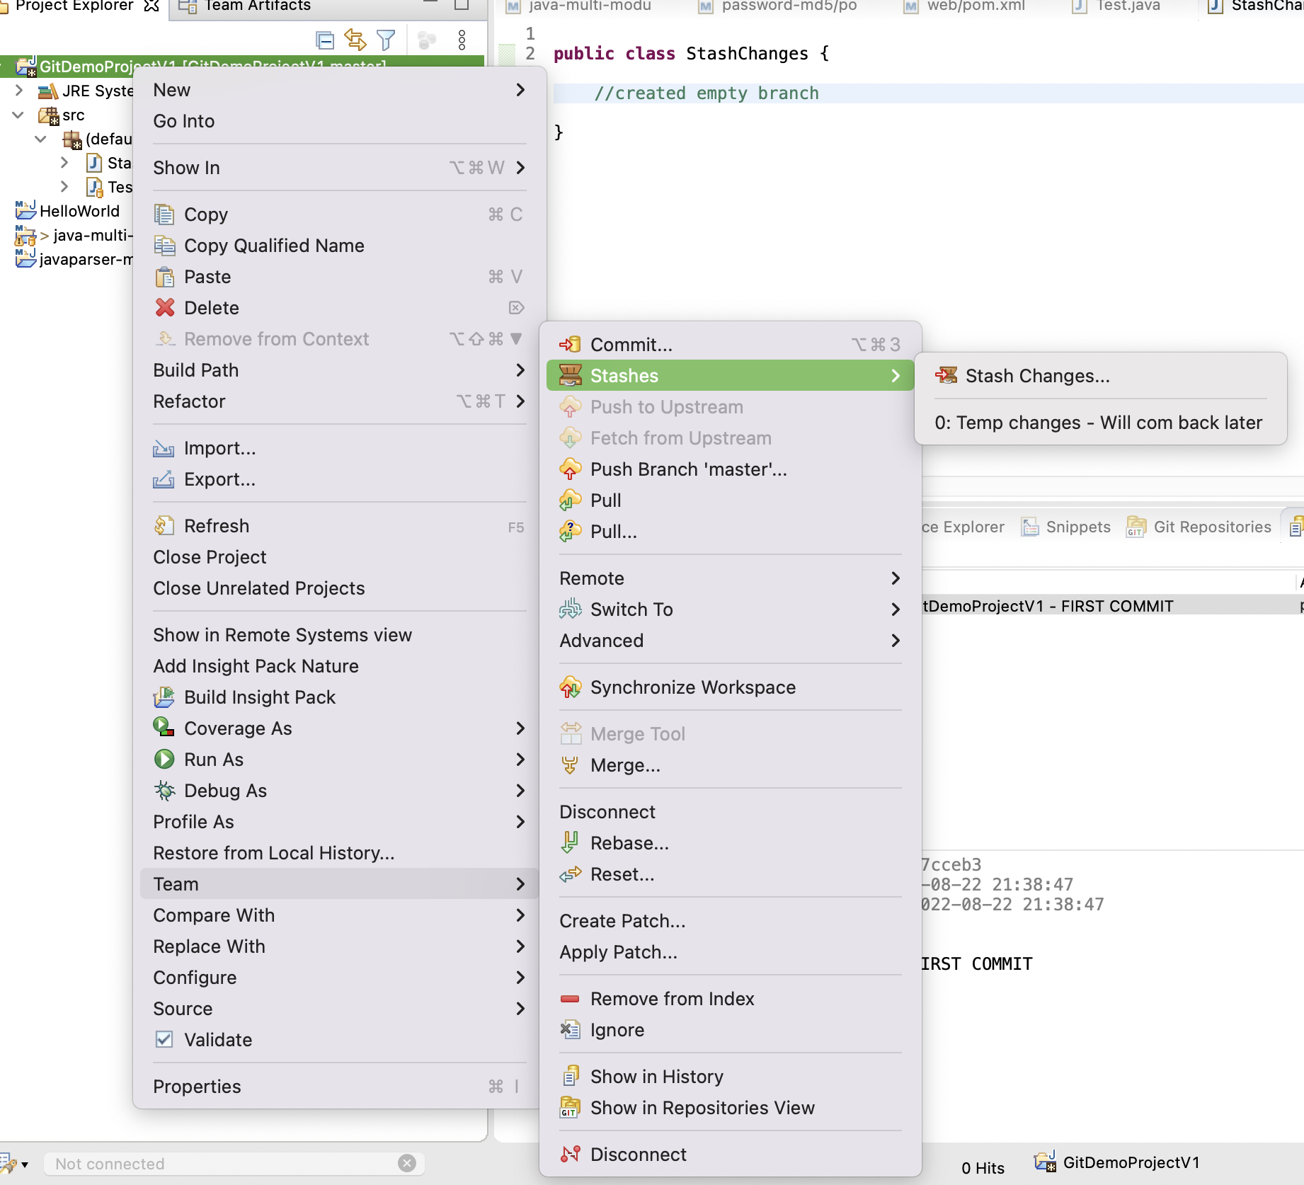
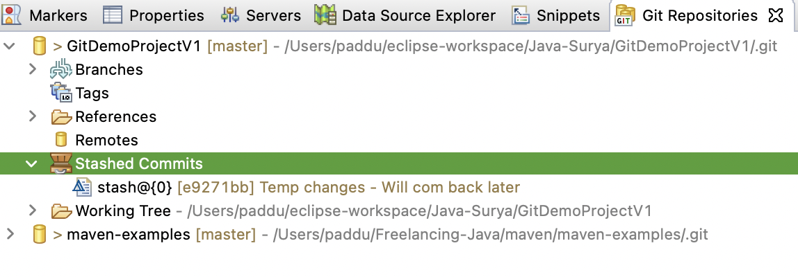
What is stash? When should developer use git stash?
Git has an area called the “stash” where you can store a snapshot of your changes without committing to the repo.
It is separate from working directory.
This functionality useful when you’ve made changes to a branch that you are not ready to commit. However, you need to switch to another branch.

Slide 23
Create conflict and resolve through eclipse
Dev1 make some changes to local files and try to push
Parallel another developer2 made the changes and pushed already to the remote.
Now developer1 try to push his changes to remote repo, while pushing he will get the conflict.
Execute git pull request to get all updated changes from remote repo
Remove the conflicts manually and add file to staging area
Commit local changes to remote repo.

Slide 24
What is GitLab?
GitLab is a web-based Git repository that provides free open and private repositories, issue-following capabilities, and wikis
It is a complete DevOps platform that enables professionals to perform all the tasks in a project—from project planning and source code management to monitoring and security
Additionally, it allows teams to collaborate and build better software.

